Slide 1


MOHAMED SATHAK A.J COLLEGE OF ENGINEERING
IOT BASED SAFETY GADGET FOR CHILD SAFETY MONITORING & NOTIFICATION

Slide 2
INDUSTRY MENTOR(S): BARADWAJ 2 EVALUATOR(S): HAMER SHIELD FACULTY MENTOR(S): S.GAYATHRI TEAM MEMBERS: BHUVANESHWARI.V.B(311819104302) NAFISA MAHIRA.K.M(311819104029) SHALINI.S(311819104044) HAMEED JAHUFAR HAJA ALAUDIN.N.H (311819104012)

Slide 3
TABLE OF CONTENTS
PROBLEM STATEMENT
PROPOSED SOLUTION
TECHNICAL ARCHITECTURE
SOLUTION ARCHITECTURE
ADVANTAGES
PREVIEW
CONCLUSION

Slide 4
PROBLEM STATEMENT: The children facing security risks are increasing day by day. So to identify and prevent children being attacked,an autonomous real-time monitoring system is necessary.

Slide 5
PROPOSED SOLUTION:
After analysing the drawbacks of the existing system, we have proposed a Child Tracking System using sensors and electronic components to detect the child's location. It also gets the details about the child's body temperature, surrounding temperature near the child, humidity of the environment , and if a child is in danger, it creates an alarm to the parents. Using this system, the parent can also create a Geo Fence around a particular location. By continuously checking the child's location notifications will be generated if the child crosses the geofence. Notifications will be sent according to the child's location to their parents or caretakers. The entire location data will be stored in the database.

Slide 6
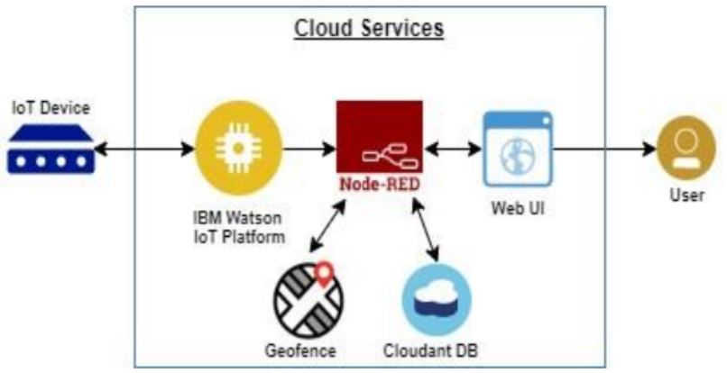
TECHNICAL ARCHITECTURE:

Slide 7
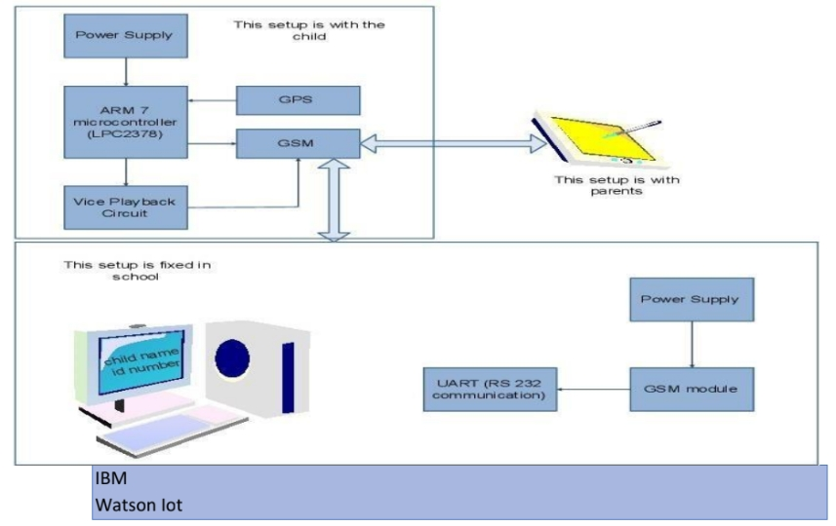
SOLUTION ARCHITECTURE:

Slide 8
ADVANTAGES:
CUSTOMIZABLE
EASY ACCESS
CAN TRACK CHILD LOCATION
SAFETY OF CHILDREN
MOBILE DEVICE ACCESSIBLE

Slide 9
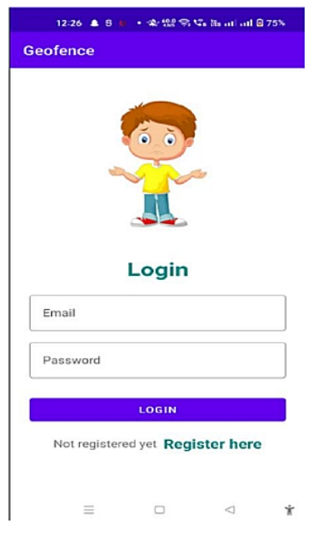
PREVIEW

Slide 10
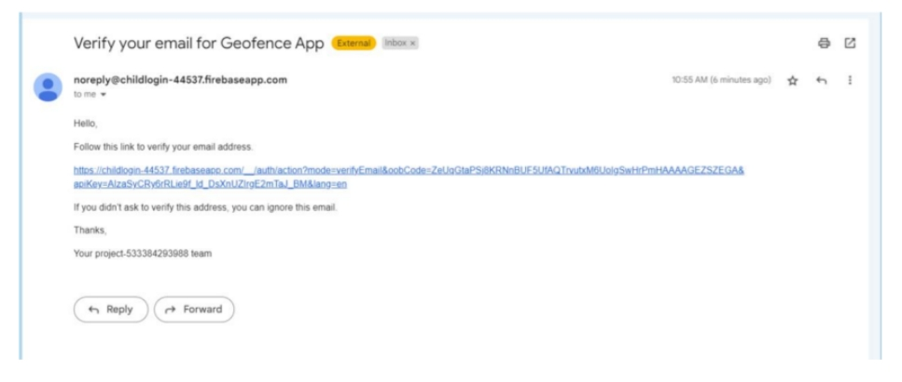

Slide 11
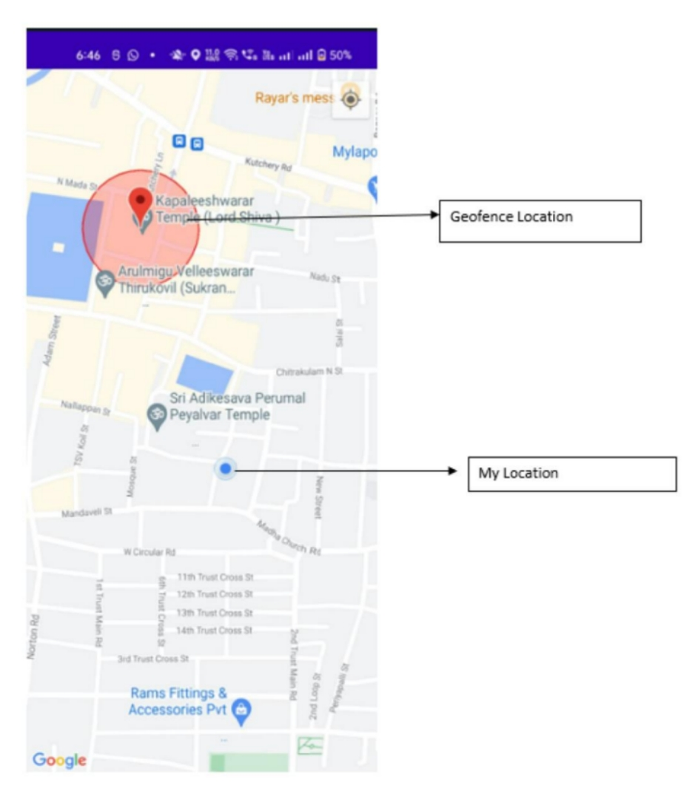

Slide 12
CONCLUSION:
Future is similar to the word children. Young people are the future pillars of one's nation, as Dr. A.P.J. Abdul Kalam once said, thus it is important to protect today's children's dreams and lives in order to give them a better future . Therefore, every parent should take good care of their own children to prevent them from being victims of abuse that will completely harm them on a physical, mental , and emotional level , wrecking our future . Due to the significance of our future, our product makes it simple for parents to track their kids and regularly visually monitor them , enabling them to assure their safety and lowering the incidence of child abuse.

Slide 13
THANK YOU

